Slide 1
Photomicrographs of Plant foods
Artichoke
Permission to reproduce original photomicrographs used to make this collection may be obtained from
Dr. David O. Norris
david.norris@colorado.edu

Slide 2
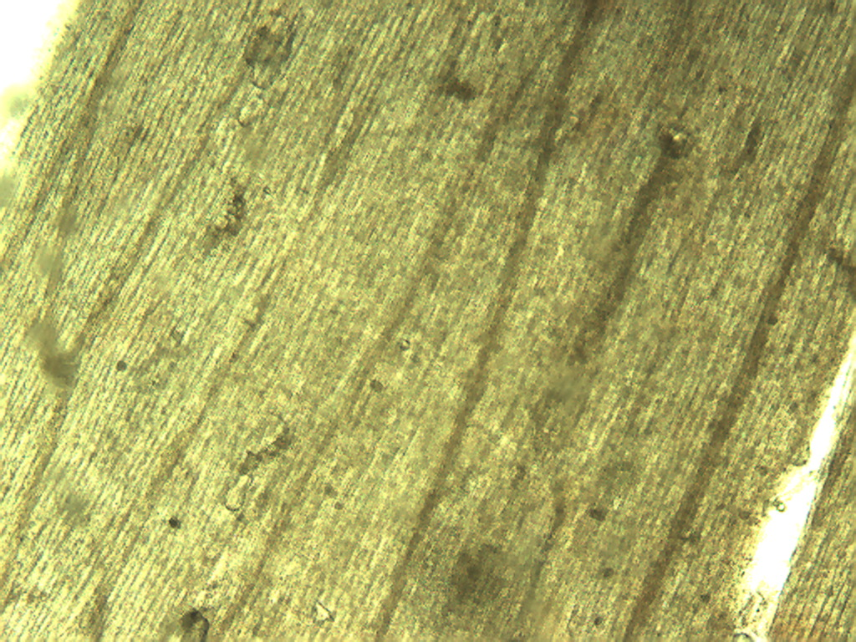
Notes:
8. Helianthus tuberosus L. Artichoke. Heart epidermis, 4X.

Slide 3
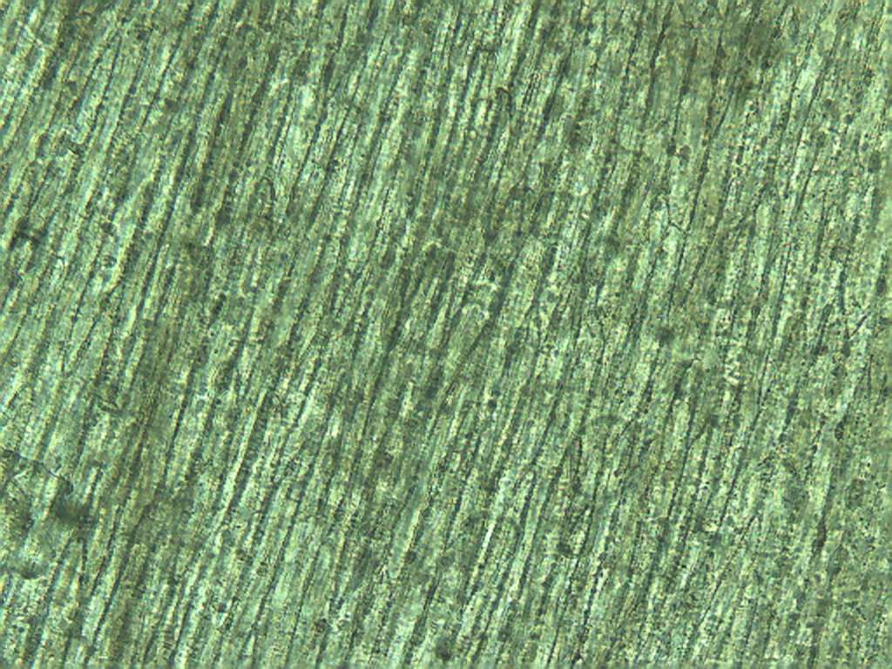
Notes:
9. Artichoke. Heart epidermis, 10X

Slide 4
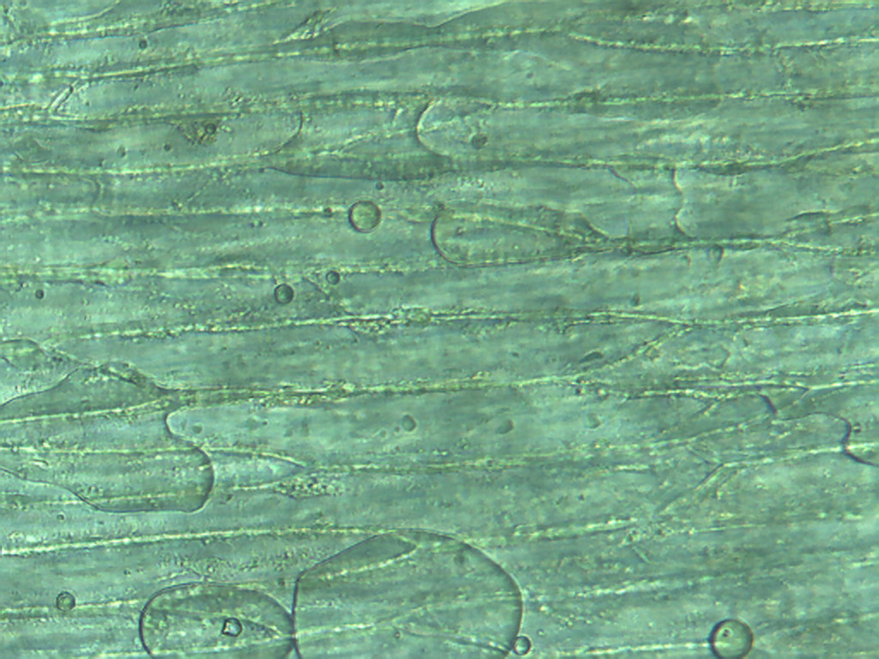
Notes:
10. Artichoke. Heart epidermis, 25X.

Slide 5
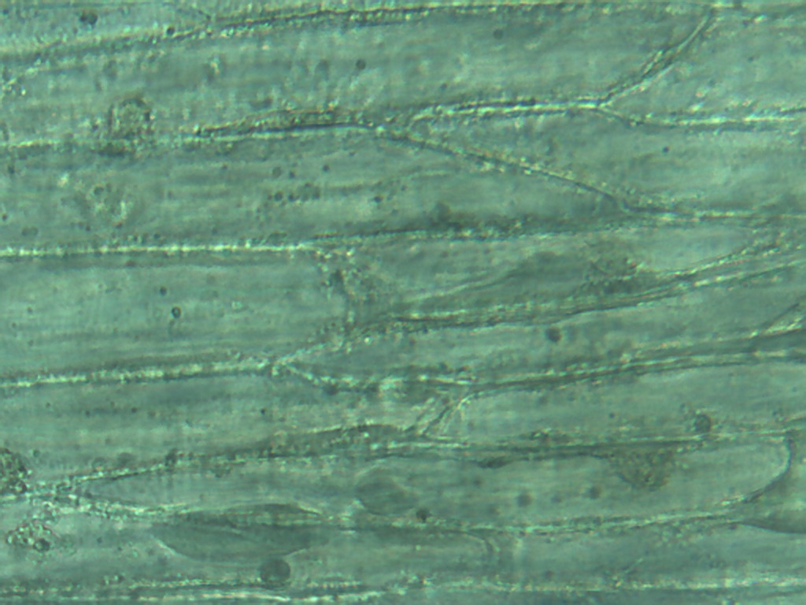
Notes:
11. Artichoke. Heart epidermis, 40X.

Slide 6
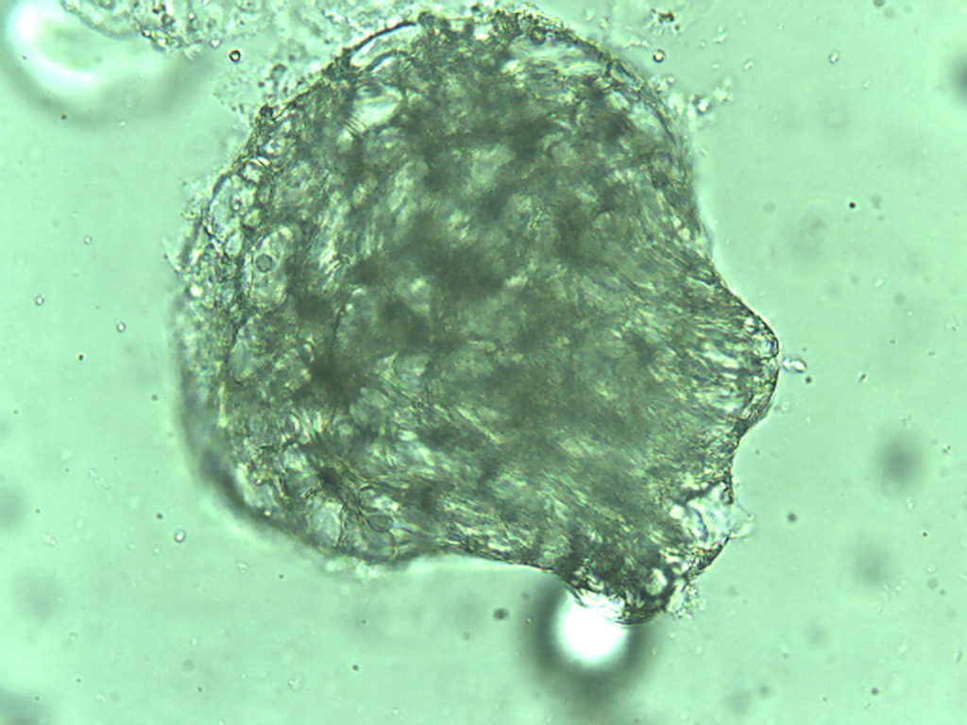
Notes:
12. Artichoke. Heart pulp, 25X.

Slide 7
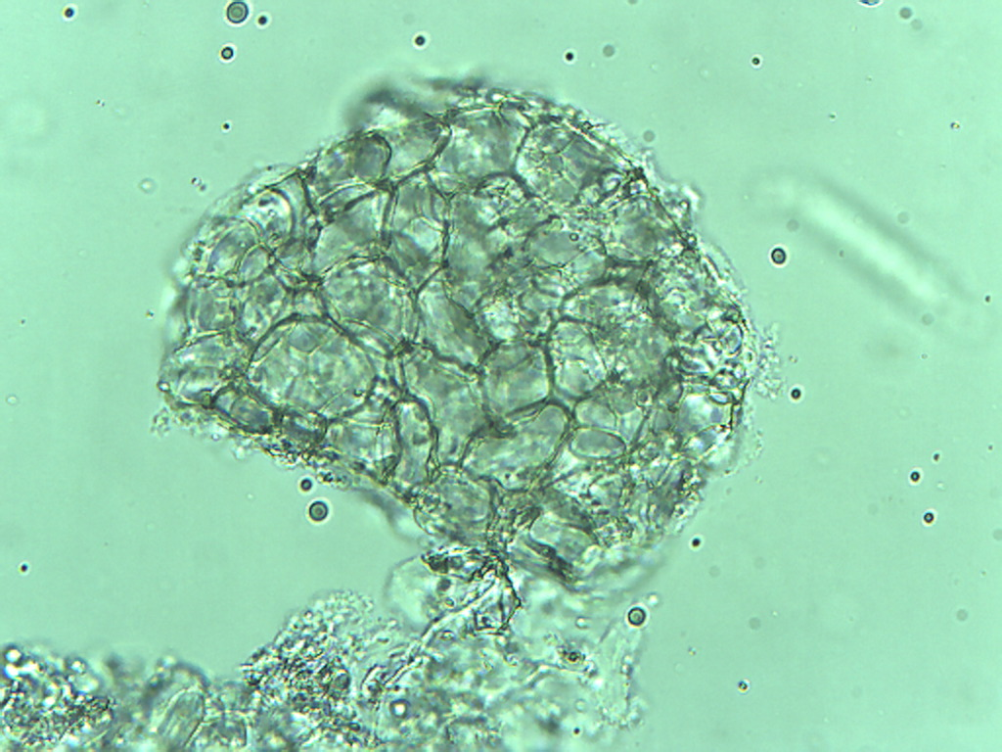
Notes:
13. Artichoke. Heart pulp, 25X.

Slide 8
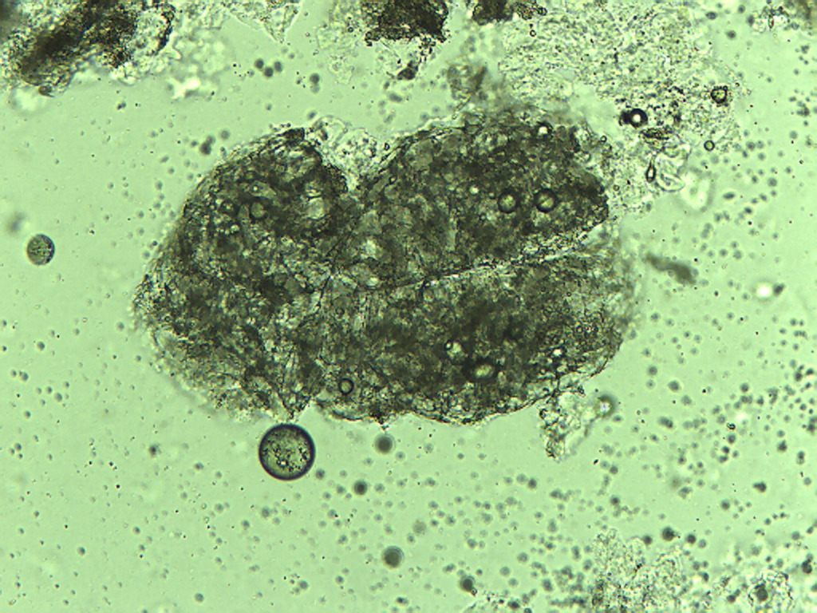
Notes:
14. Artichoke. Heart pulp, 10X.

Slide 9
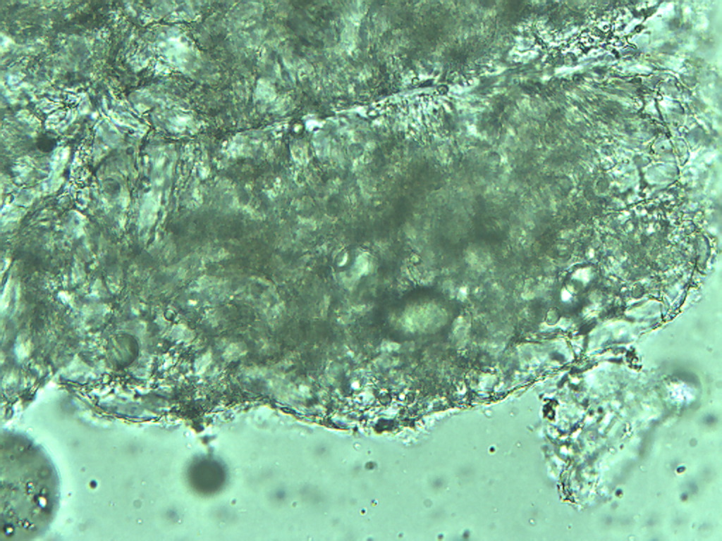
Notes:
15. Artichoke. Heart pulp, 25X.

